Slide 1
HOSPITAL MANAGEMENT SYSTEM
Group Members:
Ayesha Zia 20K-414
Syeda Ravia Ejaz 20K-0246
Hira Asif 20K-0337

Slide 2

Introduction
FAST Hospital management system is a console based program developed in C++ using DEV C++.
In the proposed system, we aimed to design an automatic-digital program which generates and manages patient records; it allows the user to enter a new patient’s information, update any previous records, search/locate any patient using the information entered and delete any records as well.
The user is able to view the record of a certain patient containing each and every detail concerning his treatment.
To access any kind of information to make changes or just view data, the user has to first verify his position.
As the system contains a login system, it can only be accessed using the correct login information and password verification.
The system maintains data security and integrity along with providing a solution to the hospital.

Slide 3
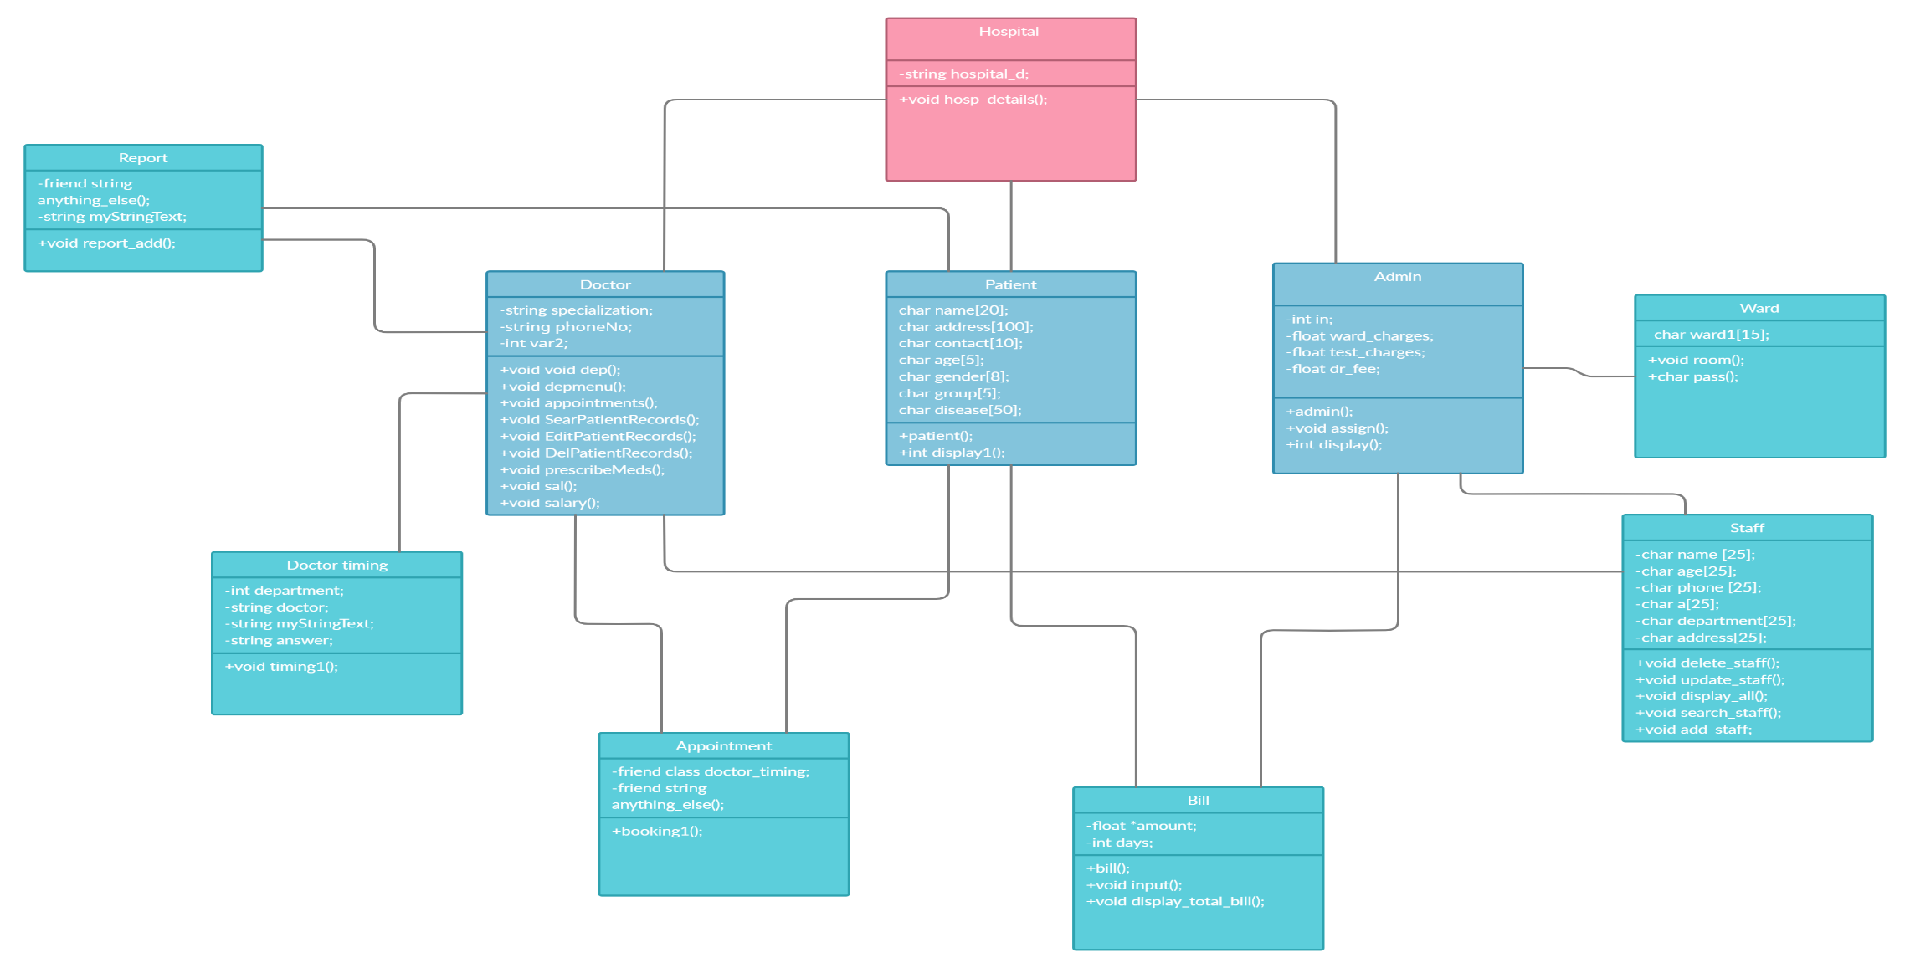
CLASS DIAGRAM

Slide 4
MODULES
MODULES FOR THE HMS
The HMS is based on four main modules:
Login
Admin
Doctor
Patient
M
O
D
U
L
E
S

Slide 5
THE LOGIN MODULE
MODULES
login module is designed for security purpose so that an unknown user will not be able to access the private information of our hospital management system.
User ID:
In the login module, the user have to input the user id first which allow the user to access the further details of the program. If the user is admin so there is one unique ID of admin which we have assigned in the program so if the user is the admin so he will access the program by entering the correct admin id. While the user ID for every doctor is different .On entering the wrong user ID, the program will ask the user again to input the user id and this will continue till 5 tries. If the user failed to enter the correct user ID, then the program will end.
Password:
After entering the user ID, the program will ask to enter the password which in case of wrong input ask it 5 more times and then terminates the program indicating that an unknown user is trying to access our program.
M
O
D
U
L
E
S

Slide 6
THE ADMIN MODULE
Admin
Book Appointments
Update Staff Records
View Patient’s Report
Check Bill

Slide 7
THE ADMIN MODULE
Book Appointments(class appointment)
The admin can book appointments for patient. The admin first creates a unique Patient ID and for that ID, a separate file is created for each patient in the system. The admin then takes the relevant information (Name, address, blood group etc) from the patient and enters it in the program. The entered information is saved in parallel in the file created.
2) Update Staff Records(class staff)
This part is allows the admin to update the staff records in three different ways along with viewing and searching for the details of any staff member:
Add new staff member details
Update staff member details
Delete record of staff member
View details of all staff members
Search for staff member

Slide 8
THE ADMIN MODULE
3) View Patient’s Report
The Admin can view the patient’s report by entering the Patient’s ID. The details of the patient are fetched from the file through getline function and displayed.
4)Check Bill:
The admin can view the total bill amount of the patient’s in their record by entering the number of days the patient kept admitted in the hospital. The bill of the patient was displayed by calculating all charges using operator overloading function.

Slide 9
THE DOCTOR MODULE
Doctor
View Appointments
Search current patient records
Edit patient records
Prescribe medicines
Delete patient records
Draw salary

Slide 10
THE DOCTOR MODULE
1.View Appointment:
The doctor can view the appointments that have been entered and saved by the admin in a text file known as “Appointments”. As the doctor selects the view appointments option, the text file is opened and all its contents are displayed for the doctor in the form of patient ID, name, and date of appointment.
2. Search patient record:
The doctor can search through patient records to view patient reports by entering patient ID. Upon the input of correct ID the respective patient report with all the patient details will be displayed.
3.Edit patient record:
The doctor can open the patient’s file by entering patient ID to edit the file by entering the diagnosis information of the patient which includes symptoms observed, disease diagnosed and any other additional information. The information entered will then be saved in the patient’s file.

Slide 11
THE DOCTOR MODULE
4.Prescribe medicine:
The doctor can prescribe medicines, tests, treatment duration, admission in hospital required and any additional information required based on the illness of the patient previously diagnosed.
5.Delete patient record:
The doctor can delete any patient records by entering the patient ID. Upon verification of the patient ID, the doctor will be asked to re-enter the password of his account in order to proceed. Once verified, the record of that patient will be deleted and a message indicating successful deletion will be displayed on the console.
6. Draw salary:
To view the monthly salary, the doctor is asked to enter if he’s worked overtime or not. After entering the number of hours worked, the salary is calculated through base salary and overtime hours. and his monthly salary is displayed.

Slide 12
THE PATIENT MODULE
New patient
Book an appointment
Check doctor’s timing
Get Hospital’s Information
Old patient
View my report
View payment history
Book new appointment

Slide 13
THE PATIENT MODULE
The patient module is based on the concept of online HMS and divided into two sections for new and old patients with different options for each; the old patient is also granted access after he/she enters his relevant details.
New Patient
Book an appointment
This works similar to the admin module(details saved to the text) with the only difference being that the patient himself can book the appointments.
2) Check doctor’s timing
The patient can choose the department and through file reading, the details of the relevant doctor are displayed. The patient is then asked if he/she wants to book an appointment and if yes, he is directed to the booking class through the class’s object.
3) Get Hospital’s Information
Through file reading, the patient is provided with the information about the hospital.

Slide 14
THE PATIENT MODULE
Old Patient
View my report
The patient can view their report(details + diagnosis) after entering their ID into the program. This is done by file reading and getline function.
2) View payment history
This directs the patient to the bill class where the bill of the patient has been previously calculated. Upon entering id, the object of bill class is called and the payment history saved in file is displayed.
3) Book new appointment
Similar to new patient, an old patient can also book another appointment if they want for any other doctor by choosing the relevant department.

Slide 15
Validation checks:
.Validation is a process which checks the validity of the values enter by the user that whether or not the value is acceptable to run the program further.
We have applied the concept of validation checks where an input is taken from the user.
On entering any value which is not acceptable by the program, the program will indicate a sign of invalid input on the screen.
The program will continue to let the user input the correct value and it will be keep on repeating the input screen unless the user enter the correct input.
Validation is applied using a while loop which runs until the value of the variable is true. When the user enter the correct input, the variable will be assigned false and the loop terminates moving the cursor to the new screen.

Slide 16
INT MAIN()
After classes of all the modules and their relevant sub-modules, the main is called.
In main, the objects of each class are created.
The modules are differentiated by if-else statements depending on the input by the user.
The sub-modules are differentiated by the switch statements and cases depending on the input by the user.
Each sub-module is a function created in each relevant class(admin, doctor, patient).
The functions are then called by the objects created for each class.
The anything_else() global function directs the user to the menu again if they want to use the program any further.

Slide 17
Object Oriented Programming techniques
Encapsulation:
It is implemented in this project through the use of classes such as Admin, Doctor, Department, Patient etc. Under each class a set of variables and functions have been binded together.
Abstraction:
The data and the functions in the classes have been set as private, public and protected. The protected, private and public data in the department, patient, ward classes can only be accessed by objects of other classes who have the permission to use it in the form of inheritance.
Inheritance:
The project has different types of inheritance such as single, multi-level, multiple, virtual and hierarchal inheritance. Class of doctor inherits from Department, Patient and Ward class (multiple inheritance). Classes Admin and Doctor virtually inherit from class Ward due to their common child class Staff. There are many other examples in the code.

Slide 18
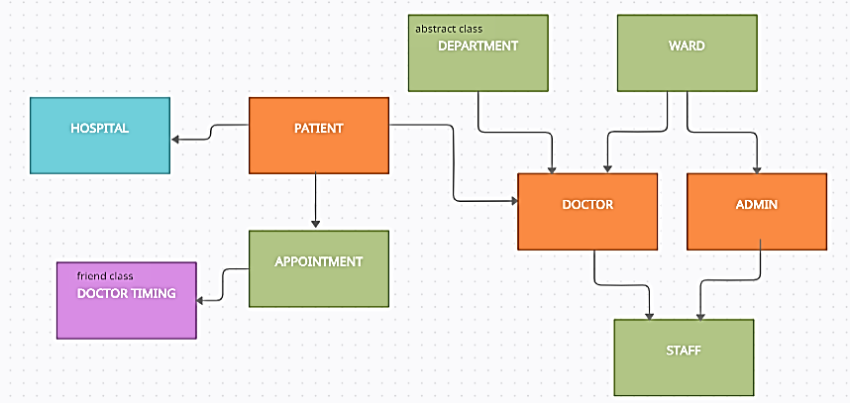
Object Oriented Programming techniques
Inheritance:
The project has different types of inheritance such as single, multi-level, multiple, virtual and hierarchal inheritance. Class of doctor inherits from Department, Patient and Ward class (multiple inheritance). Classes Admin and Doctor virtually inherit from class Ward due to their common child class Staff. There are many other examples in the code.

Slide 19
Object Oriented Programming techniques
Polymorphism:
The project implements compile time and runtime polymorphism in the form of function overloading in almost all the classes and operator overloading in the Bill class.
Abstract class:
The Department class is an abstract class which has three pure virtual functions: depmenu(), dep(), and salary. The definition of these functions is in the child class of Doctor.
Friend class and friend functions:
Doctor_timing is a friend class of the class Appointment, hence, giving it access to its private data members and functions to implement it for its own purpose. The function anything_else is a friend function of the classes Admin, Appointment, Doctor_timing and Report which allows the function to perform any other tasks than one given.

Slide 20
GLOBAL + GENERIC FUNCTION(Templates)
One important feature of C++ is templates which allows to create generic function or generic programs in c++.
In our program, a global function is used when the user wants to return to the menu screen.
This function is then converted into generic function to access it with multiple data types and to reuse the code.
Here, templates are used to convert global function into generic function.
The function ask the user to move the cursor back to the menu screen, if the user allows, the cursor will be moved to the menu screen else it will end the program.

Slide 21
CONCEPTS OF OOP USED IN THE PROJECT
The program uses the following tools taught in the Object Oriented Programming course:
Inheritance and its different types
Polymorphism(operator overloading, function overloading, function overriding)
Filing
Static variables
Friend function
Friend class
Abstract class
Constructors (copy, default and parameterized)
Templates
Switch and Conditional statements(If/else/else-if)
Loops (for, while and do-while)
Dynamic memory allocation

Slide 22
CONCLUSION
To sum up, the making of the project was an immense learning experience and we have achieved all the outcomes that we had previously stated as problems in our proposal.
Through the use of the program created, hospitals can easily access, maintain patients information, provide better services and as well as secure their patients data.
The previous manual version of the hospital management system has been enhanced and modified using object oriented programming and C++ language techniques such as encapsulation, abstraction, runtime and compile time polymorphism, inheritance, abstract classes, friend classes, friend functions, virtual functions, filing, strings, conditional statements, arrays and loops.
Our aim was to create a program with an easily understandable UI for the hospitals so they could easily provide quality services to their patients: make appointments, create new patient entries, update by adding patient treatment information or delete pre-existing records, search up and view records. In the end, along with having a deeper understanding of OOP and C++language.

Slide 23
THANK YOU!

